Slide 1

Firestarter Methodology
When you have enough matches, you can fire up your app

Slide 2
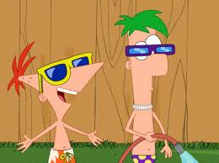
What we’re going to do
Talk about the process of creating web based applications
Talk about how they have a tendency to change
Talk about the FireStarter methodology which seeks to minimize risk on changes
Today an overview on the main points of the Firestarter methodology
Next week, more specific techniques to use

Slide 3
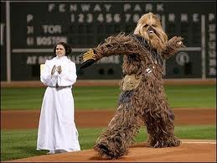
Here’s the pitch
The methodology I am talking about is created by me
Would love to have collaborators on:
Manifesto
Yes, manic people tend to write manifestos
Share ideas on boundaries/methodology
Create preferences (Not best practices)
Share techniques
But let’s go ahead and start

Slide 4

A different idea
Test Driven Development tries to prevent you from making mistakes
FireStarter takes a different approach
FireStarter wants to allow you to change your application without fear of breaking it
This allows to better use tools and not waste your time on trivial items
But to understand this better, you must first think about how you make an app

Slide 5

The making of an app
Gather specifications
Model the data process in the database
Model
Create a way to pull/push that data into/from the app
DAL
Create a way for the app interact with that data
Controller
Create a façade to interact for the customer to use
View

Slide 6

How things can change
Database changes
Logic of application changes
Interface or façade changes
Specification changes which affects one or all of above

Slide 7

Don’t test everything
Façade
Don’t ever test for classes, style, placement
You will be punished for this mistake
Disallows you to use design time controls
You need a human
Human judgment is a must for approval of any application
Any method that doesn’t have humans as final unit test has a problem

Slide 8
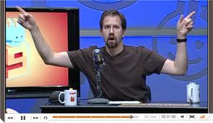
The inspiration
As a reaction to the notion that JavaScript’s lack of type system is an issue:
“The compiler is just the first unit test” -Scott Hanselman, Microsoft MVP
My reaction to this is:
“The compiler is the first unit test; you should make sure you use it to its fullest potential”
-don-E Merson

Slide 9

The second source of inspiration
From my Dad:
Choose the simplest option
Don’t run when you can walk
Don’t walk when you can stand
Don’t stand when you can sit
Don’t sit when you can lay down
If someone wants to do your work, let them

Slide 10

DesignTime Controls are RAD
The whole point of OOP was to make small independent pieces of code
Design Time Controls are small independent pieces of code
They are designed to allow you to do things you do often with ease
They are designed to allow predictable changes
So Dad would say:
Let someone else do your work

Slide 11

Problems with other agile methods
Totally dismiss design time controls
Programmer centric on their testing, not enough recognition of human wants and needs
Test to too small of detail due to lack of design time controls
So let’s look at FireStarter Principles

Slide 12

Main principles
We want to make changing the application as easy as possible at every stage of development
Thus
Use design time controls when available
Use auto-generated toolsets when possible
Use the compiler as your first really good unit test
Don’t have magic values control logic, encapsulate that value
Tests are required for everything that is left

Slide 13

We want to catch when our code breaks due to change
Use strongly typed objects always!
Encapsulate strings into compiler verifiable items
Decrease dependencies
Encapsulate boundaries

Slide 14
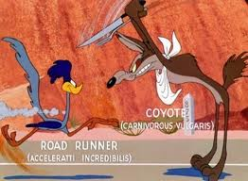
One trick to testing Forms is..
Make all the forms into webcontrols (.ascx)
Create a Test Page
Setup Data for Test
Load Web Controls dynamically into page
Run your test on the Page_PreRenderComplete

Slide 15
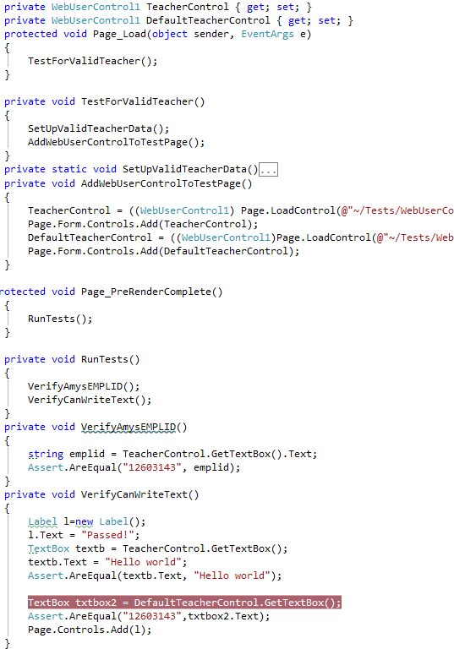
Example
Note –Need Public methods

Slide 16
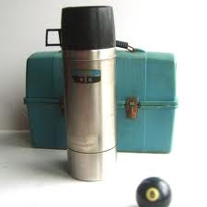
We should test as little as possible
Only test things the compiler can’t catch
If it is just display, your compiler can catch it
If need to verify data, see previous template
Going to show you another method
Use data as a refactoring tool
We use the data that we used doing our tests and generate them into strongly typed objects
See template later

Slide 17
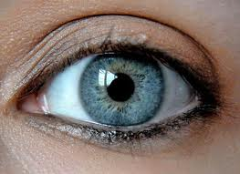
Don’t test things a human must approve
Don’t test appearance
Appearance should be as abstract as possible
Css file
Well named classes
Make sure you have a list of human only approvable tasks
Make sure a human goes through this list before deployment
Make sure to note the note the scope of human testable items
A single page test with no dependents requires only 1 page view

Slide 18

Match Game PM
Firestarter testing is based on matching items as they go from layer to layer of abstraction
Firestarter testing also encourages matching ideas about “how to code” to how things are coded

Slide 19

The Matches
Data Store to Data Classes
Controls on page meet required controls
Controls values to DAL Values
Magic values to compiled values
Conditional logic to unit tests
Human eyes meet human desires

Slide 20

Keep the fire burning
Test methods match the mental representations of what is being tested
Class names match their mental representative
Function names match the mental representations of the actions they model
All of the functions match only one level of abstraction
Property names match the mental representations of the describers they model
Classes are either Data or Logic, not both

Slide 21

Water to the fire
Logic relies on hard coded value versus an abstraction
Direct contact with the data store or outside source
Untestable objects
Intertwined dependencies

Slide 22
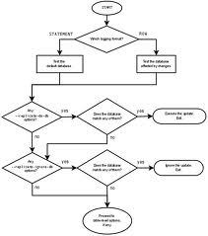
The most important match is the Database to DAL
Thus, the method recommends to
Use a generation tool to detect change
SubSonic is recommendation
Other tools in the CodeSmith
This works hand in hand with only using strongly typed values from the DAL in your code
Let’s look at an example of how this works

Slide 23
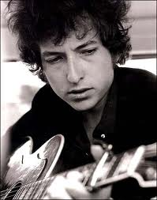
The times they are a’changin’
SubSonic generates strongly typed objects
Thought Experiment…
You change a name or type of a field
When you run SubSonic the compiler will find all of the changes
You remove a field, same result
You add a field that doesn’t effect any current code, SubSonic doesn’t bother you
This is a really quick unit test

Slide 24
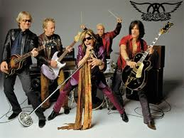
Living on the edge
Strongly Returned types from Stored Procedures
SubSonic will let you change and doesn’t check until runtime
Could add to do test to verify this
We will talk about how to fix this later

Slide 25

Session variables are shy
They don’t let you know when you misspell them
Encapsulate them
Config file or function
Same with cookies, request strings, etc.
You can write code to look for enum pulled from database
Never tie logic to a string in code

Slide 26

Be Mr. Spock
Any type of logic that changes behavior or results should have a test
You can code first, then make test
This is more abstract so let’s do some examples

Slide 27

Test one
Scenario is ….
If the user has a record display it, else ask them to select from a list of defaults
Let’s encapsule the logic
Bool CanDisplayRecord(currentUser)
This is testable, you mock different users
This leads me to a more important point

Slide 28

Program first, encapsulate next
Don’t hard code objects to test but use auto generation
For example you might want to mock up a user with admin privileges or no admin privileges
Don’t write out the item by hand
Enter users in the database first while you are using your application
Encapsulate the object to allow going into test mode
Use CodeSmith to auto generate the data you have created for testing in the future

Slide 29
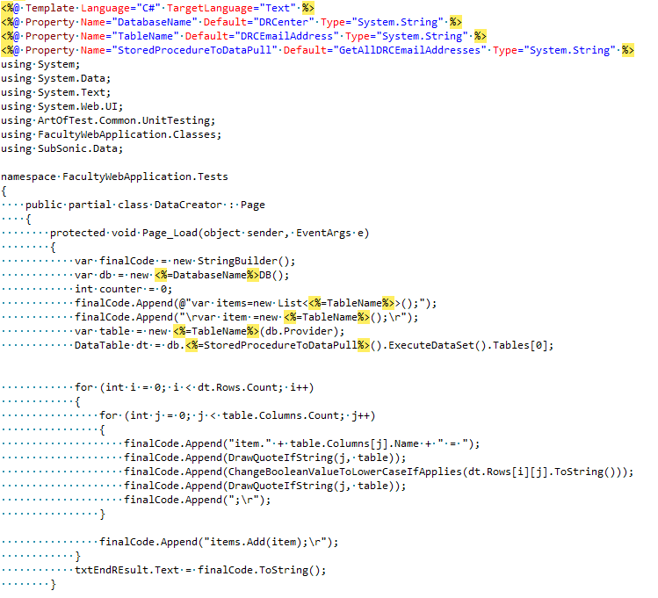
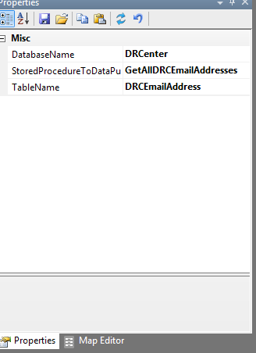
Creating test scenarios after the fact
Can use my template to pull out data

Slide 30
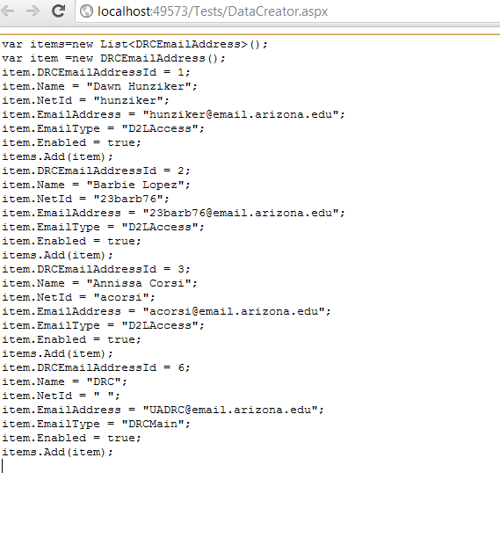
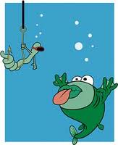
Can Mock up data quickly
The result

Slide 31
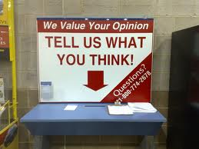
Suggestions
Start your test stored procs with Test, Mock or some other convention
Make sure your name matches mock proc
My suggestion =“Test<NameOfProc><What>
GetUser
TestGetUserWithAdminPrivs

Slide 32

Important to encapsulate DAL
Allows you to go into test mode
Factory factory=new Factory()
factory.TestMode=true;
if TestMode use autogenerated test objects

Slide 33

You can send the objects
You can send webcontrols as parameters
TextBox DoFunkyDisplayLogic(TextBox object)
This pattern makes this function testable

Slide 34
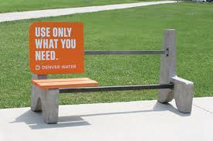
Give an ID and runat server for anything you need
If a certain bit requires a div for the logic
Adding the hard coded item in the code behind doesn’t let someone delete it by accident
Just a add a function called CheckForRequiredItems() in the cs file
Don’t need to call, just use the compiler to verify its presence

Slide 35
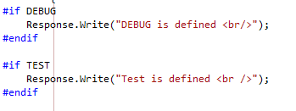
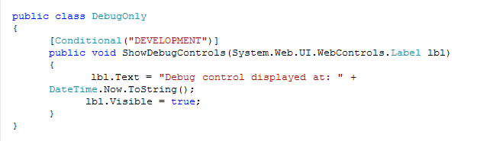
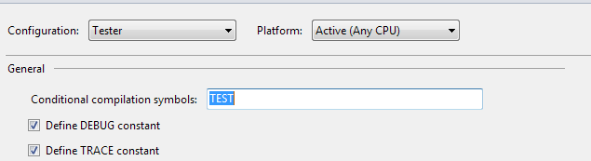
Or use #if Condition tags

Slide 36

Which leads me to the real heresy
Put your test code in the project you are testing
You can make conditionals to not deploy it
Prefer simple over complex
Less projects makes upgrades easier
Never add a separate logic project unless another project will need same logic
Don’t use DAL project-autogenerate

Slide 37
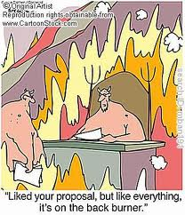
One quick aside
Need to add one important point here
Your testing should be your documentation
It is better to have documentation near the function
Put your test code next to the thing they test
I will show a good technique for this later
For now, have the tests next to item tested
Have them in a #region tag

Slide 38
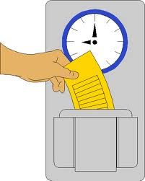
Make sure to note the time
Write functions so that they cannot be called out of order
Bad
GetData()
DisplayData()
Better
DisplayData(GetData())

Slide 39

Kindle your code
Make abstractions in code that model the real world
CurrentUser class
IsAdmin as a bool
GetDataForPage()
CheckForException(ItemToCheck)
Every line of code should mean only one abstraction

Slide 40
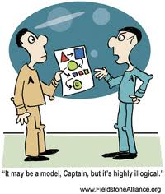
Add some logic in cs to help verify design time controls
If a RadGrid relies on a certain object having certain names you need to allow the compiler to check for those items
This is an after the fact, last thing to do but it IS a test
Make a function, not called that pulls out the strongly typed object
Can be optional if you want flexibility in production
Not sure it is worth the risk

Slide 41
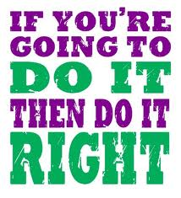
If you write it right
Single Abstractions are easy to test
Well Named Classes are easy to remember
Well Named Functions don’t need comments
Well written is easy to debug

Slide 42

Last important point
This is an after the fact type of testing
You make the database->compiler verifies
You make your pages->compiler verifies
You create your logic->tests verifies
You encapsulate items after the fact

Slide 43
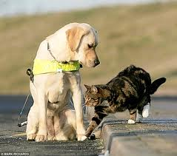
How to guide
Create your database
Auto generate your DAL
Create your pages
Use strongly typed objects
Make sure compiler catches any important objects
Enter your data
Create an abstraction layer above the database
Auto generate your data into test cases
Create your logic tests
Any logic left over that changes behavior needs a test
Refactor so your mom would understand your code

Slide 44

And one last oddity
Make sure to have a list of human validation tasks that are required before any deployment
Maybe even have this list in the database
Required humans to intervene and bless the published product
Still contemplating options

Slide 45

Option ideas
Have a table in the database with human verification task
Create interface to check off items that puts in date
When finished puts in date for hour into future
Don’t allow compile unless the date is in the future

Slide 46

And that is the main point
Don’t compile unless you are ready to play
Make the compiler the best unit test in the world

Slide 47
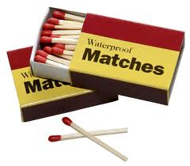
Use these matches
And you’re ready to fire up your application in confidence
And you know it won’t flame out
And more importantly, this allows you to make changes or refactor with confidence

